Slide 1

Topic 2: Python Program Elements
Part 1: Explain Variable and data types in Python

Slide 2
Variable Names
Variables are containers for storing data values.
Variable can be string, integer, float.
A variable can have a short name (like x and y) or a more descriptive name (age, carname, total_volume). Rules for Python variables:A variable name must start with a letter or the underscore character
A variable name cannot start with a number
A variable name can only contain alpha-numeric characters and underscores (A-z, 0-9, and _ )
Variable names are case-sensitive (age, Age and AGE are three different variables)

Slide 3
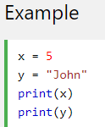
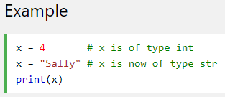
Variables
Python has no command for declaring a variable. Example
Variables do not need to be declared with any particular type, and can even change type after they have been set. Example

Slide 4
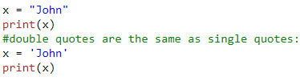
Single or Double Quotes
String variables can be declared either by using single or double quotes

Slide 5

Case-Sensitive
Variable names are case-sensitive.
This will create two variables
Example.

Slide 6
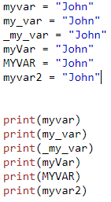
Legal variable names:
Example

Slide 7

Illegal variable names (NOT USE):
Example

Slide 8

Many Values to Multiple Variables
Python allows you to assign values to multiple variables in one line
Example

Slide 9

One Value to Multiple Variables
assign the same value to multiple variables in one line
Example

Slide 10
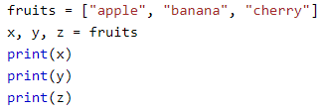
Unpack a Collection
a collection of values in a list, tuple etc. Python allows you extract the values into variables. This is called unpacking.
Example of unpack a list

Slide 11


Output Variables
The Python print statement is often used to output variables.
To combine both text and a variable, Python uses the + character
use the + character to add a variable to another variable

Slide 12


Output Variables cont…
For numbers, the + character works as a mathematical operator
Example
CAN NOT combine a string and a number, Python will give you an error

Slide 13
Exercises
1. Create a variable named bunga and assign the value Teratai to it.
Answer :
2. Create a variable named x and assign the value 50 to it
Answer :
3. Display the sum of 5 + 10, using two variables: x and y
answer: ______
y = 10
print(x ____y)
4. Create a variable called z, assign x + y to it, and display the result
Answer: x = 5
y = 10
= x + y
print( )

